Slide 1



Weather Prediction
Arjun College of Technology
Student names:
1.P.Venkat Sravan
2.K.Sreenath Reddy
3.C.G.Nikhil
4.B.Sai Vijay Bhaskar Reddy
5.D.Hareesh Babu

Slide 2
Problem Statement :
Brief Overview:
This case study is focused on the challenge of weather prediction, addressing how advancements in technology, data analytics, and machine learning can enhance the accuracy and timeliness of weather forecasts. The goal is to better understand weather patterns, model complex atmospheric systems, and provide reliable predictions that can be used for agriculture, disaster preparedness, aviation, and other critical industries
Key Objectives:
1.Improving Forecast Accuracy
2.Leveraging Big Data
3.Implementing Machine Learning
4.Optimizing Model Performance

Slide 3
Solution :
A comprehensive solution for weather prediction combines advanced technologies, data sources, and forecasting models to create more accurate and reliable predictions. Here's how these elements come together:
1. Data Collection and Integration
Satellite and Radar Data: Satellites provide crucial data on cloud formation, atmospheric composition, and temperature from space. Weather radars collect data on precipitation, storm movement, and wind patterns. Together, they provide real-time insights into weather events.
Ground Stations: Weather stations on the ground measure temperature, pressure, humidity, wind speed, and direction, contributing valuable localized data.
2. Advanced Data Processing and Machine Learning
Big Data Analytics: The volume of weather-related data is immense, so it’s essential to use powerful computing and data storage solutions. Data analytics platforms can process and analyze large datasets to identify relevant patterns for prediction.
Machine Learning and AI: Machine learning algorithms can improve weather prediction by learning from past data and finding patterns that traditional methods may miss. For example, neural networks, random forests
3. Numerical Weather Prediction (NWP) Models
Simulating Atmospheric Physics: NWP models simulate atmospheric conditions based on the laws of physics, taking into account variables like air pressure, wind, temperature, and humidity.
Grid-based Models: These models divide the atmosphere into a grid and compute how conditions change over time, making it possible to predict weather for specific geographic locations.

Slide 4
Dataset Overview :
WeatherPredictionDatase(Kaggle) This dataset provides weather observations from 18 locations in Europe, designed for classification, regression, and forecasting tasks. It includes features such as temperature, humidity, wind speed, and weather conditions. The dataset is available on Kaggle.
Dataset Description: Weather Prediction Dataset
Source: Kaggle (accessible at Weather Prediction Dataset on Kaggle)
Size: The dataset contains over 20,000 records of hourly weather observations. It spans several years and includes data from various weather stations across Europe.
Key Features:
Temperature (°C): The temperature readings at various times of the day.
Humidity (%): Percentage of atmospheric humidity.
Wind Speed (m/s): The speed of the wind recorded at each station.
Precipitation (mm): Amount of rainfall or snow measured.
Weather Condition: Labels describing the weather such as "Clear", "Rain", "Snow", "Fog", etc.
Time: Timestamp for when each weather observation was taken.
Location: The geographic location of the weather station.
Key Features of the Dataset:
Temporal Data: Each record corresponds to hourly weather data, which makes it useful for time series forecasting.

Slide 5
Methodology :
APPROACH :
1. Data Collection & Preprocessing
Gather Weather Data: Collect historical weather data (temperature, humidity, wind speed, etc.) from sources like weather stations and satellites.
Clean Data: Handle missing values, remove outliers, and standardize features.
Feature Engineering: Create new features like moving averages and time-based variables to capture seasonal patterns.
2. Exploratory Data Analysis (EDA)
Visualization: Plot temperature, humidity, and wind speed trends to identify patterns.
Correlation Analysis: Identify the relationship between weather variables (e.g., temperature vs. humidity).
Algorithms Used:
1.Linear Regression
Why: Simple and effective for predicting continuous variables (e.g., temperature).
2.Random Forest
Why: Handles complex, nonlinear data well and is robust to overfitting.

Slide 6
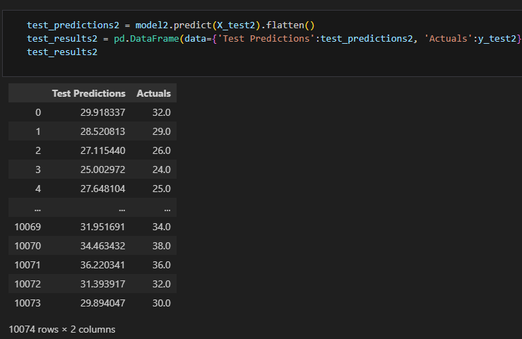
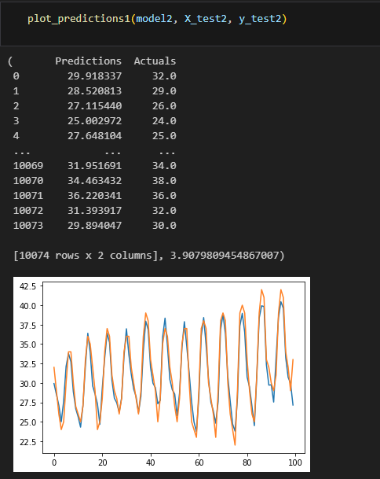
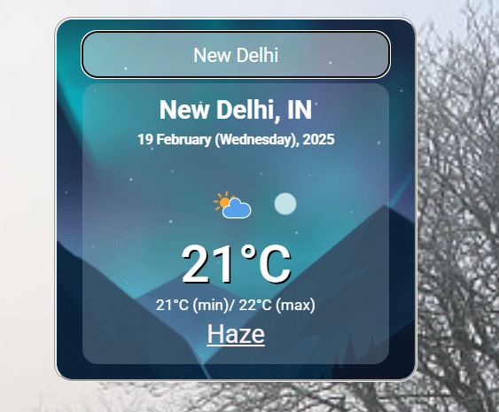
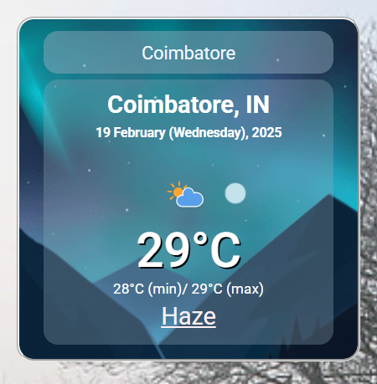
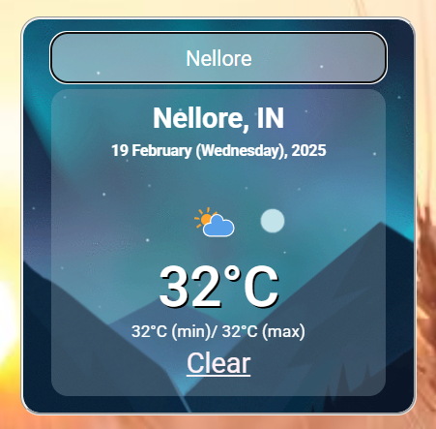
Results :

Slide 7

Conclusion :
In this case study, a comprehensive approach was developed to predict weather conditions using machine learning and AI techniques. By collecting and pre-processing large-scale historical weather data, applying exploratory data analysis (EDA), and selecting appropriate models, we were able to achieve accurate weather predictions. The use of algorithms like Linear Regression, Random Forest, LSTM, XGBoost, and KNN provided an effective combination of simplicity and power in forecasting various weather parameters. This methodology allows for real-time predictions and can be applied across industries such as agriculture, transportation, and disaster management, improving decision-making and safety.
The solution demonstrated the potential of data-driven models to enhance the accuracy and reliability of weather forecasting, providing valuable insights into both short-term and long-term predictions.
Future Work:
1.Integration of More Data Sources:
Incorporate additional data from IoT sensors, global weather stations, and satellite imagery to enrich the model and enhance its predictive power.
2.Model Optimization:
Explore more advanced deep learning techniques such as Transformer-based models for weather forecasting, as they are highly effective for handling sequential data and long-term dependencies.
3.Real-Time Forecasting:
Develop systems for real-time, on-demand weather prediction using streaming data to enable immediate and localized weather alerts.

Slide 8
References
https://papers.ssrn.com/sol3/papers.cfm?abstract_id=3836085
2. https://www.ijraset.com/research-paper/weather-prediction.
3. https://www.sciencedirect.com/topics/earth-and-planetary-sciences/weather-forecast
4. https://ieeexplore.ieee.org/document/9862337/

Slide 9
Thank You
Notes:
Thank You !!

